Slide 1
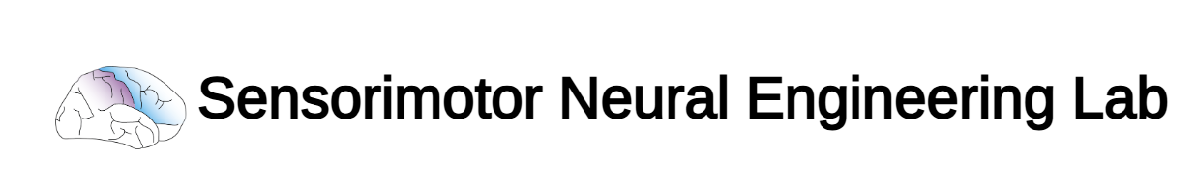
Phil, Zeyad, Tom Update
3/17/25

Slide 2
Contents
Overall System Architecture - Phil
Applicator - Zeyad
Performance of Strain Sensors - Tom

Slide 3
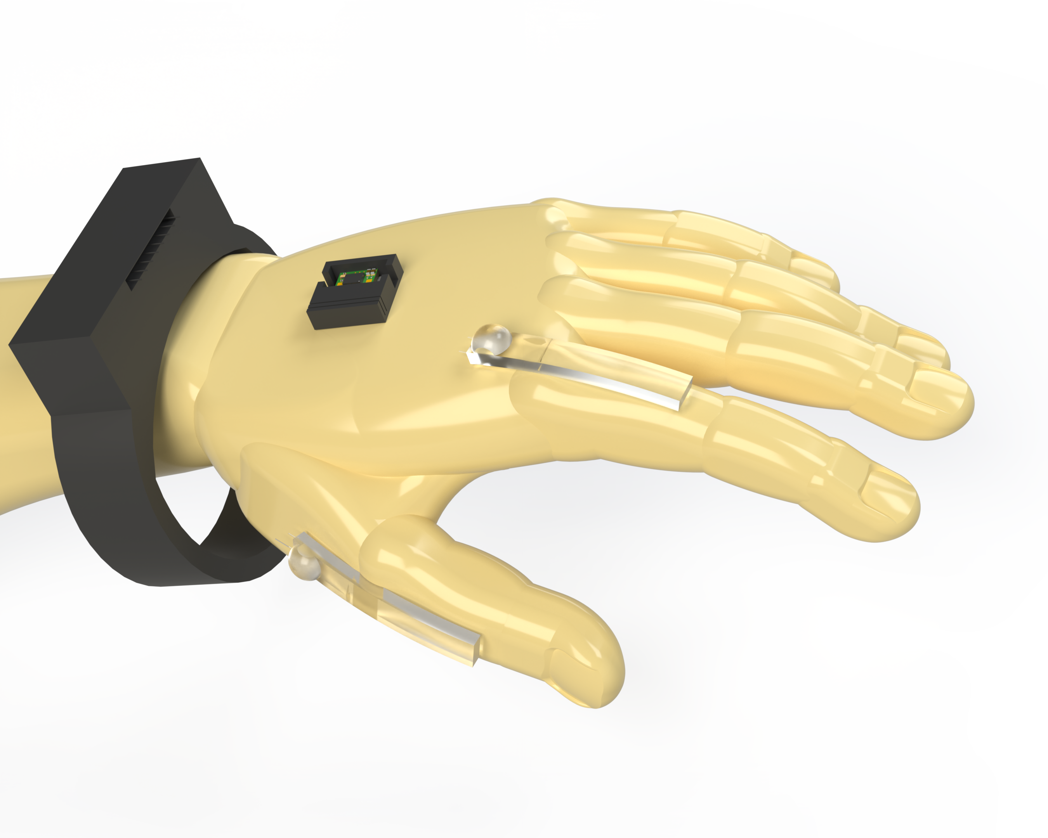
System Architecture

Slide 4
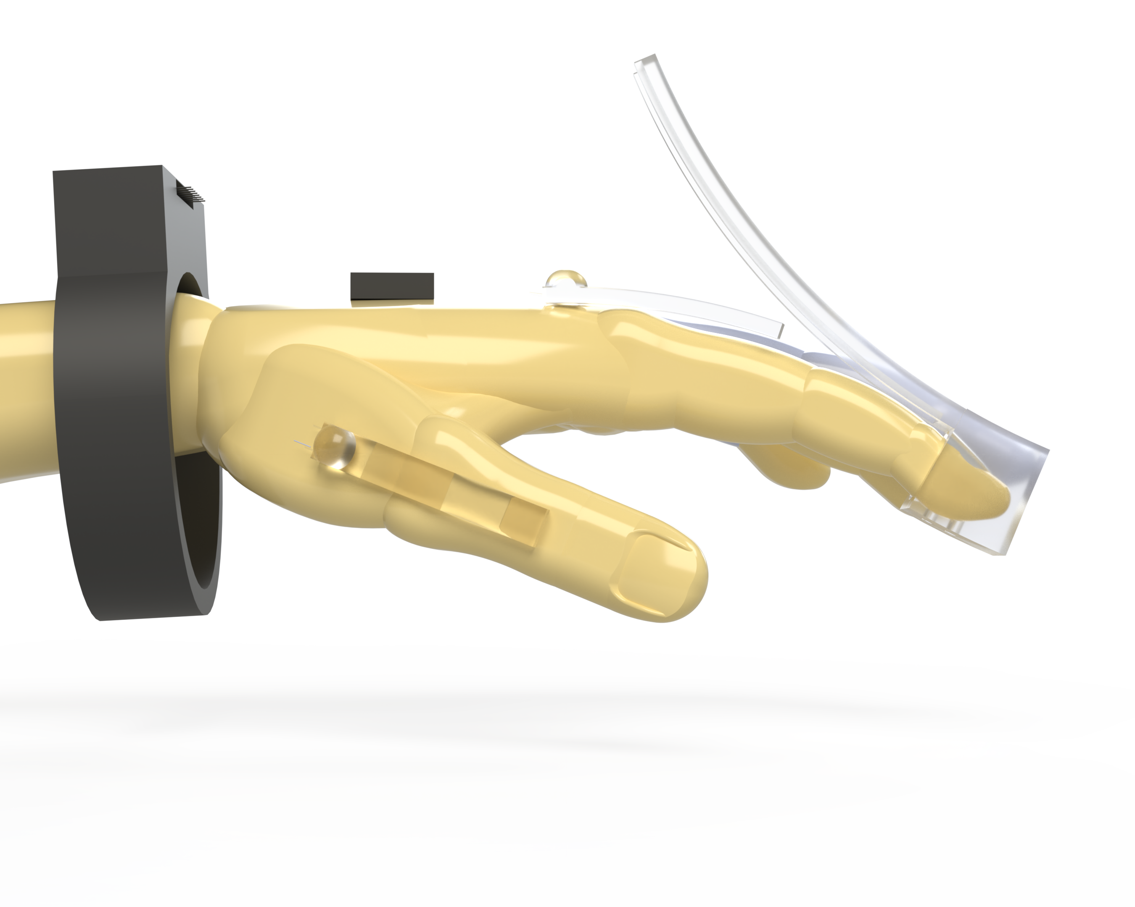
Strain Sensors with Applicator

Slide 5
Strain Sensors

Slide 6
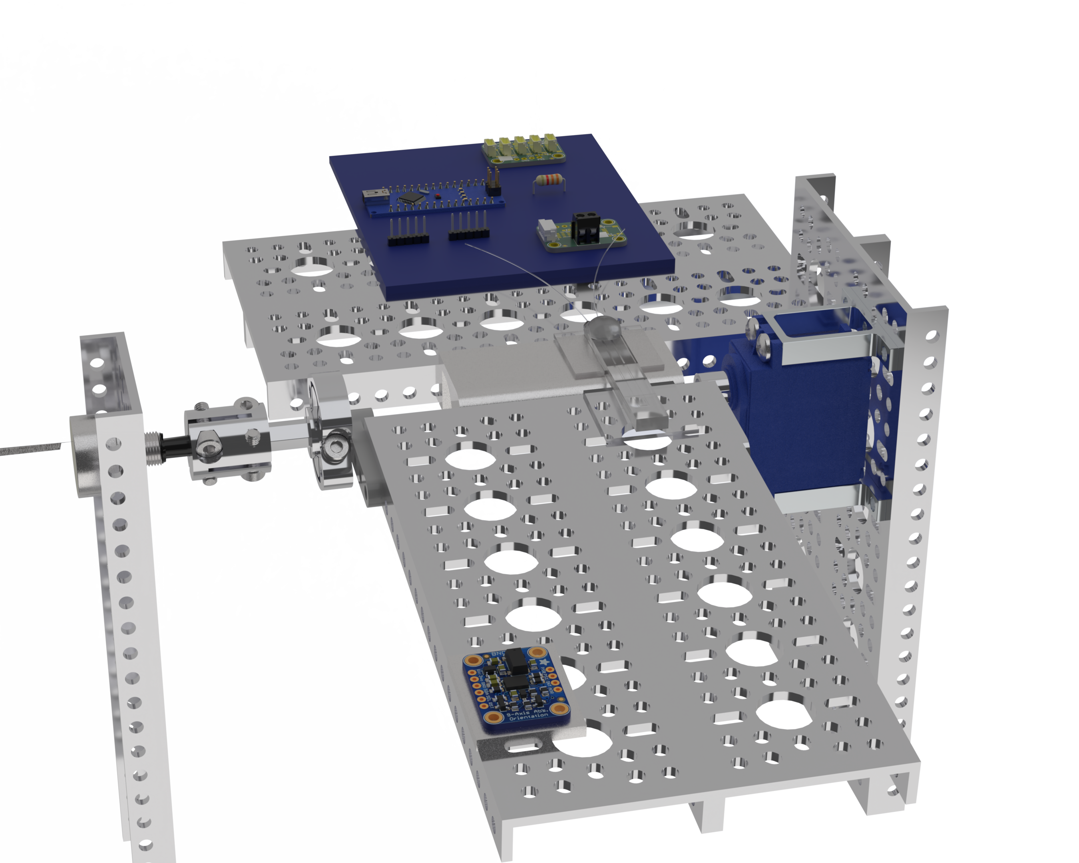
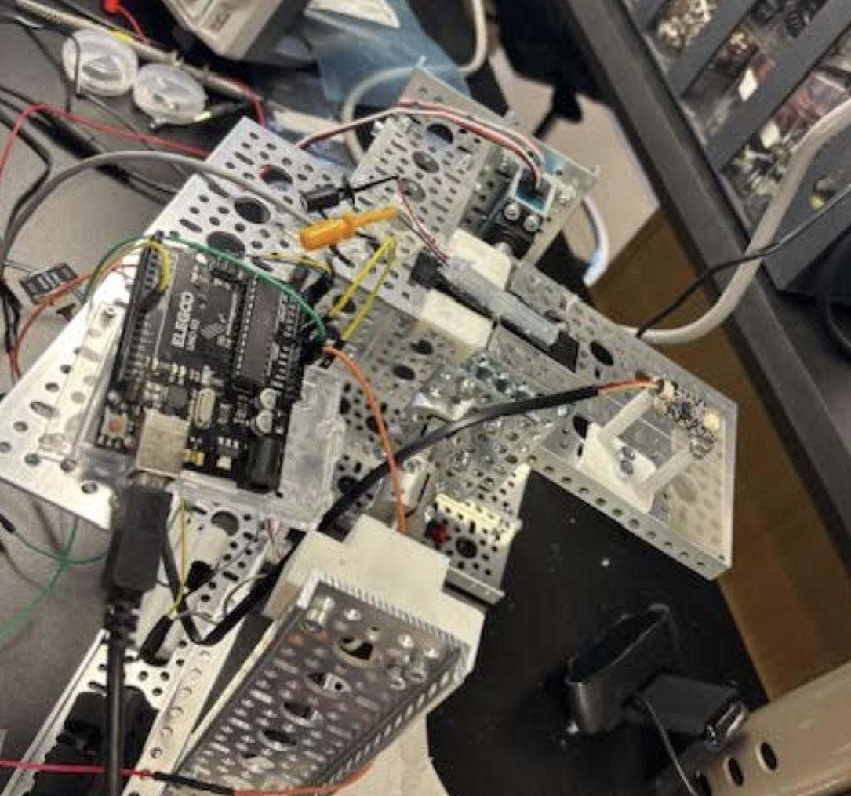
Auto Bender “Controlled” Testing
Hall Effect Rotary Encoder 0-320 deg
MCP3421 ADC
Servo
IMU

Slide 7
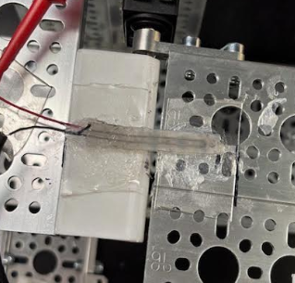

Slide 8
Circuit 4: 65.5 mA through Divider
50 ohm (2 precision 100 ohm in parallel)
- Would sometimes have to change this resistance to avoid clipping on ADC
Strain Gauge (0.4 ohm – 1.2 ohm)
GND
3.3V 800mA Linear Voltage Regulator - LD1117-3.3 TO-220
w/ in and out 10 uF electrolytic caps for stability
GND
x 76
LMC6492 Non-Inverting Opamp (75kohm/1kohm)
GND
2.048V ref (LM4040)
~1.99V to 5.87V
x 2
MCP3421 I2C (16 bit resolution)
Arduino Uno I2C

Slide 9
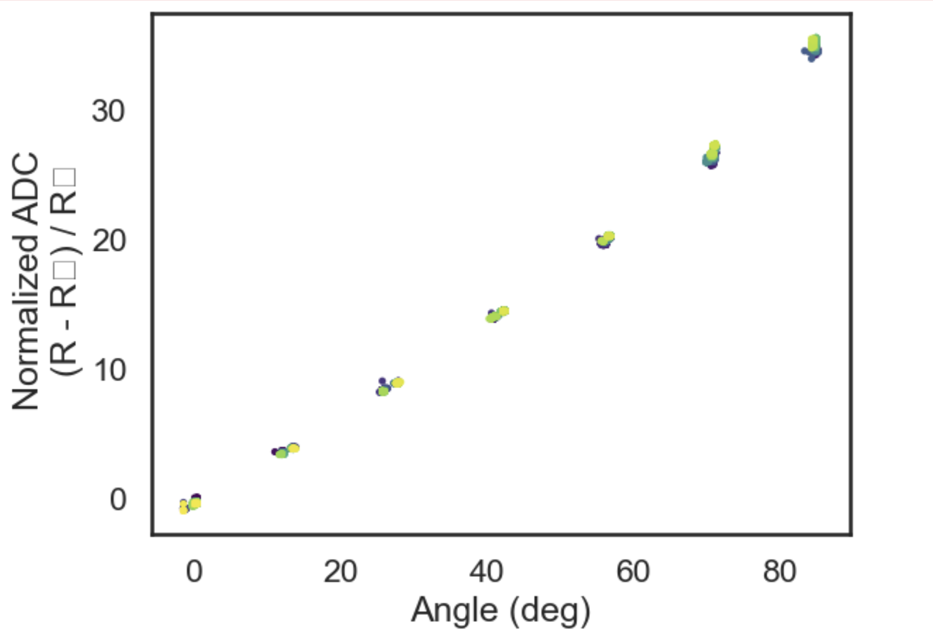

Slide 10
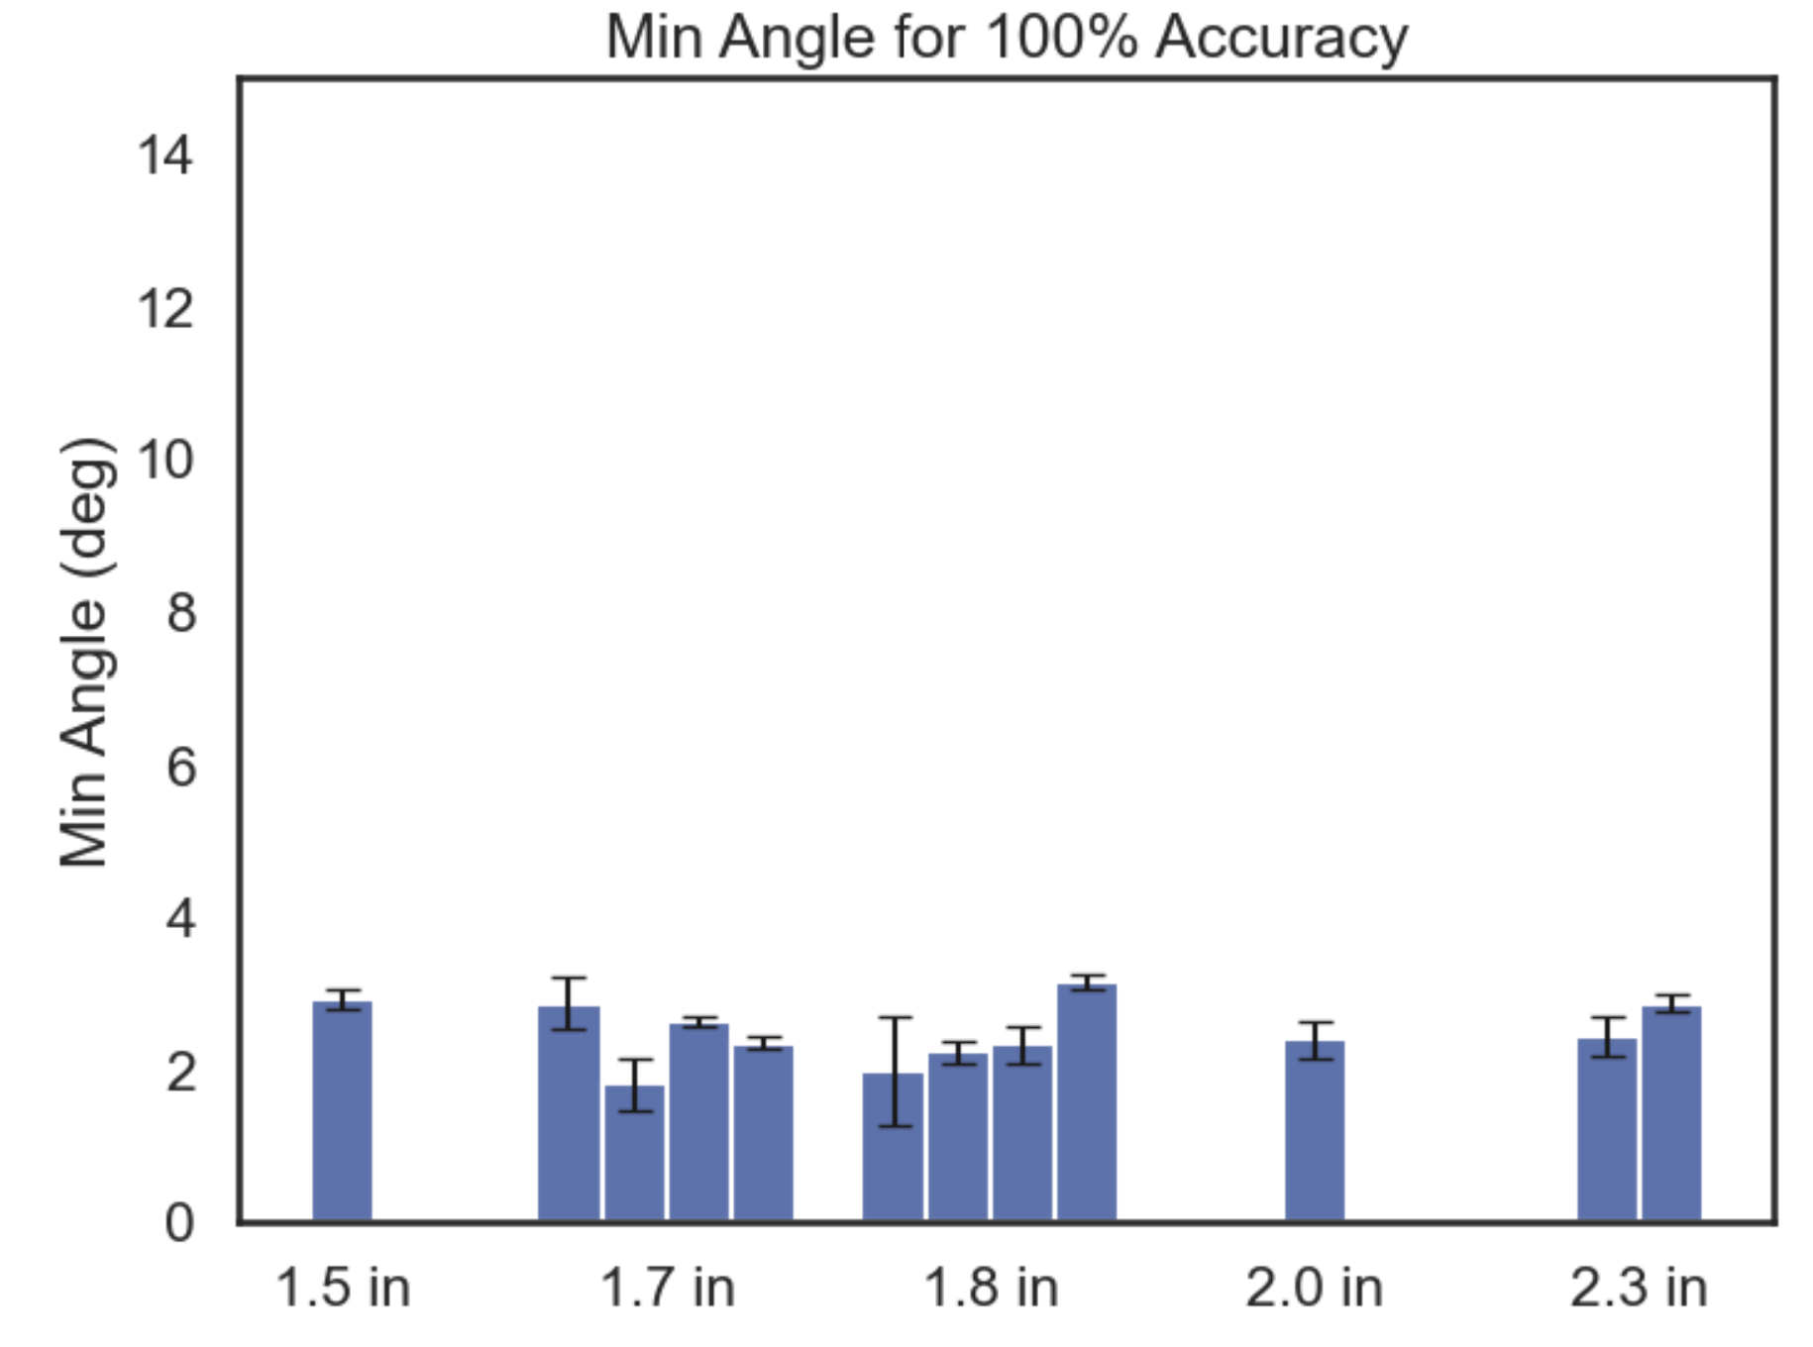
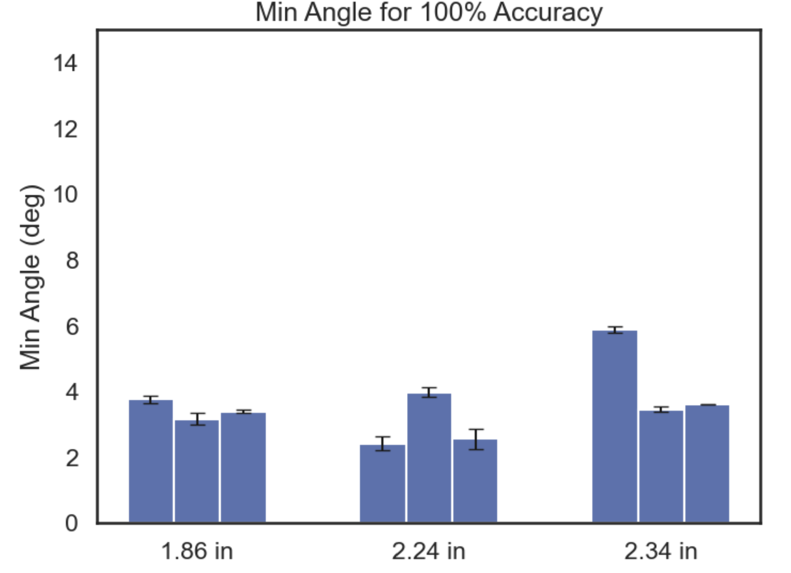
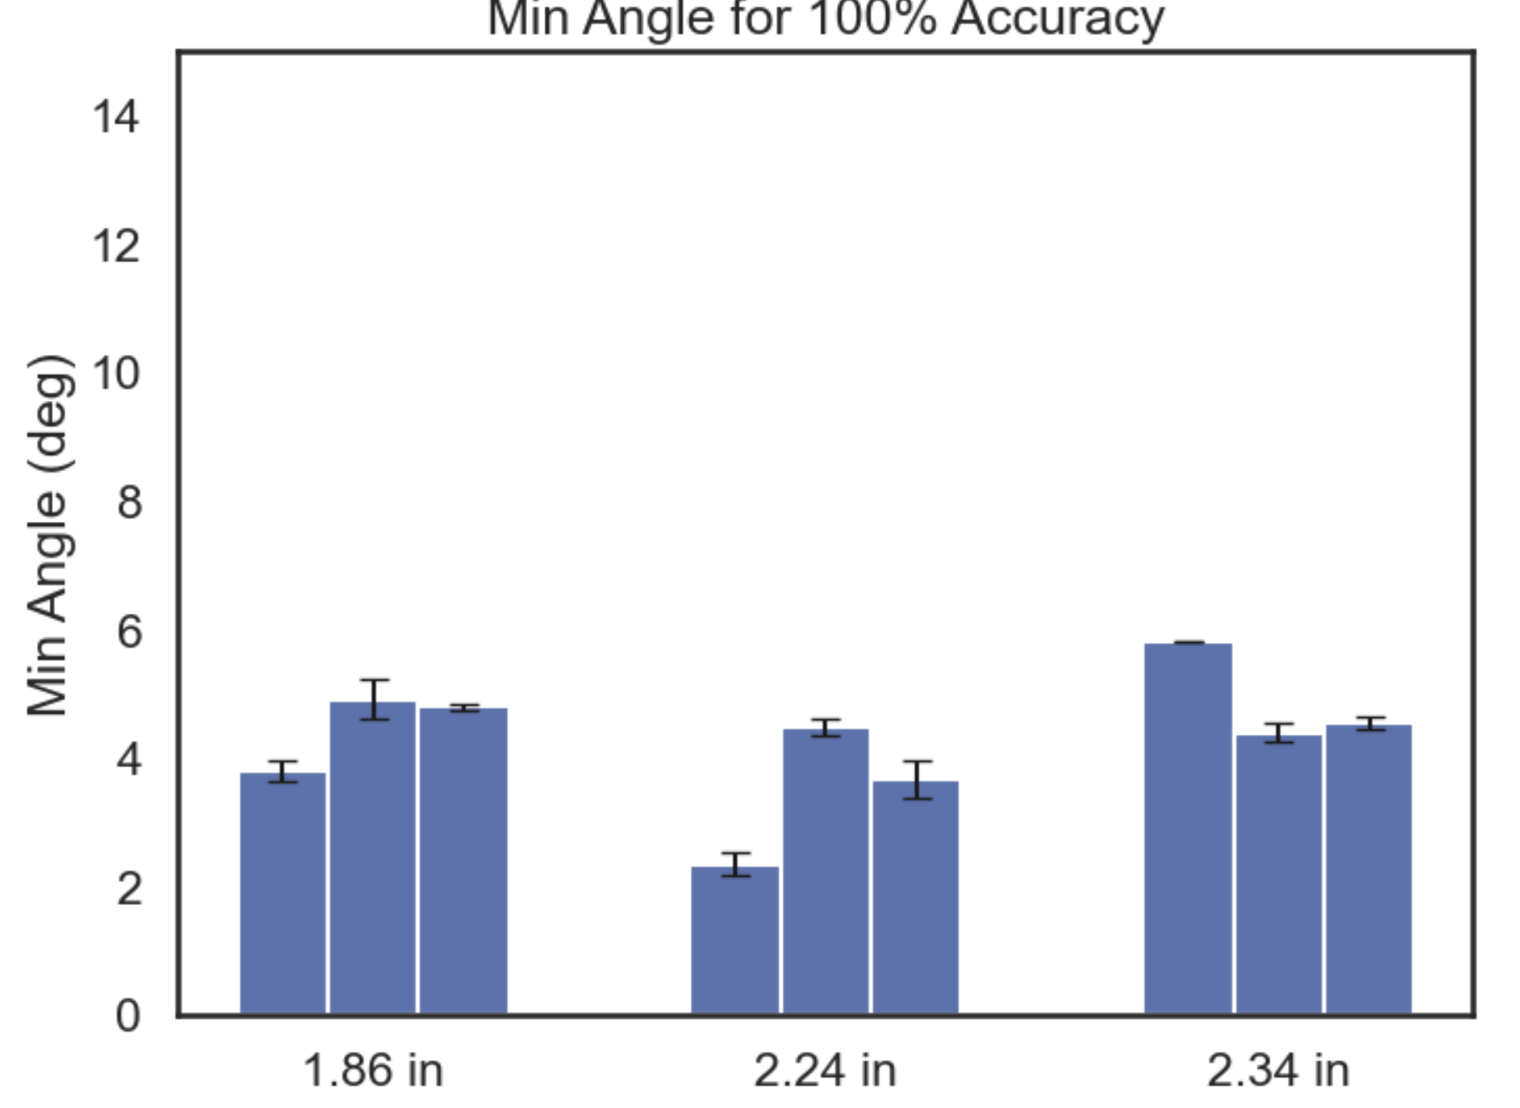
Different Length Samples Norm 0 to 1
Reapplication Data Norm 0 to 1
Misalignment Data (0, 10, 20 deg) Norm 0 to 1

Slide 11
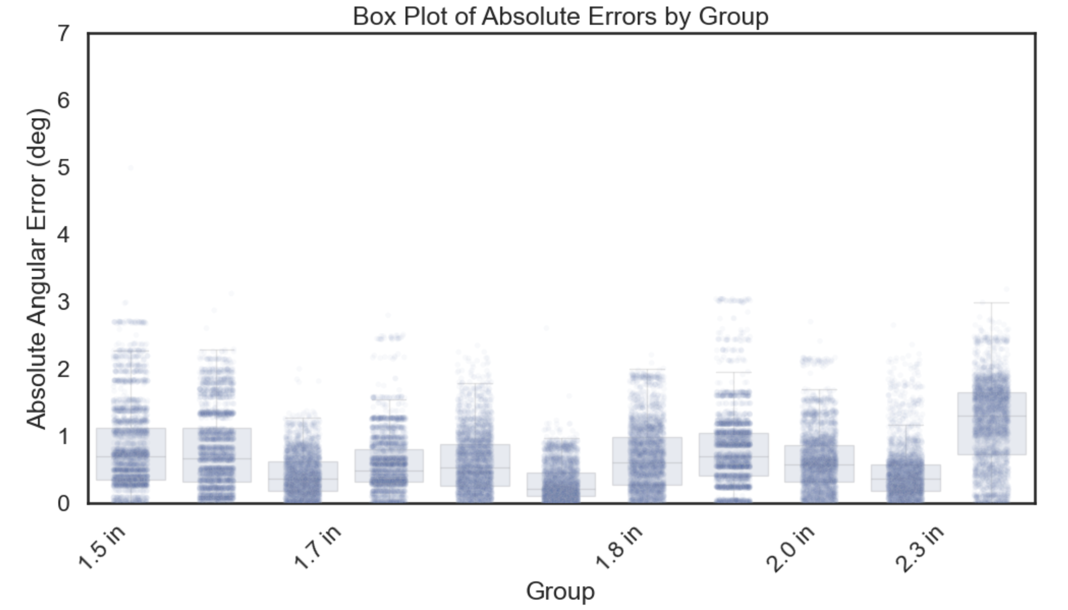
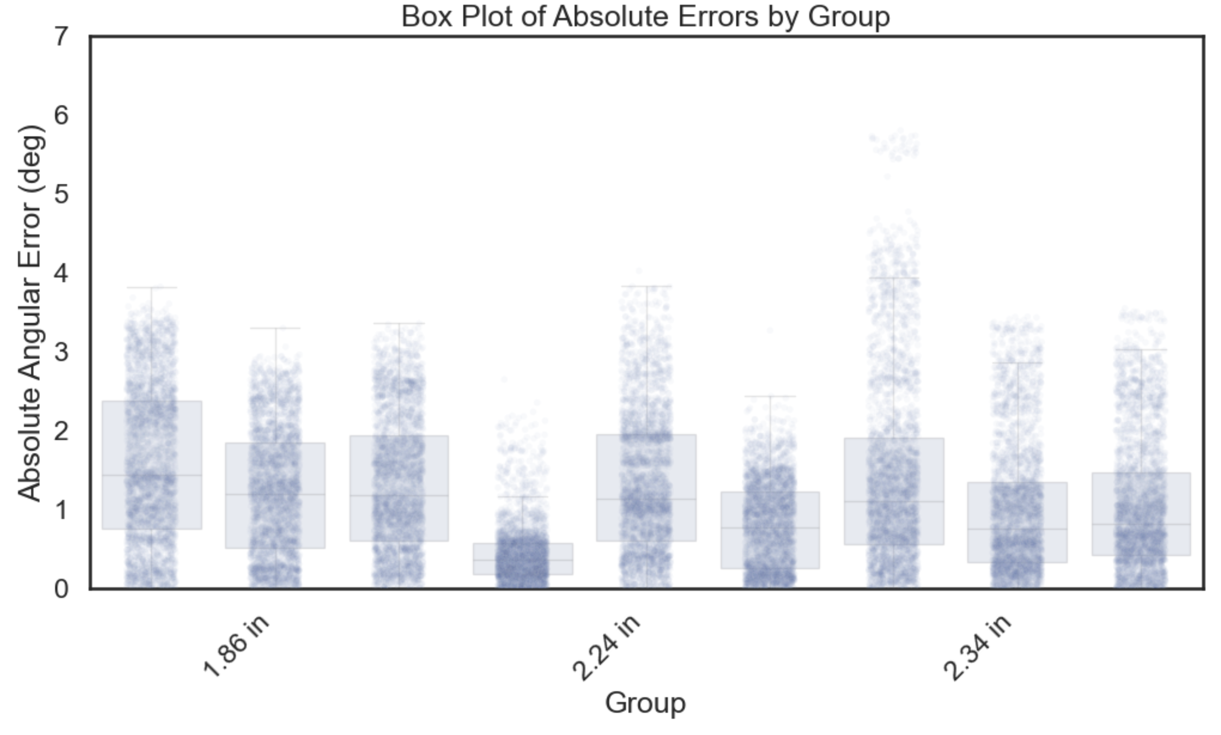
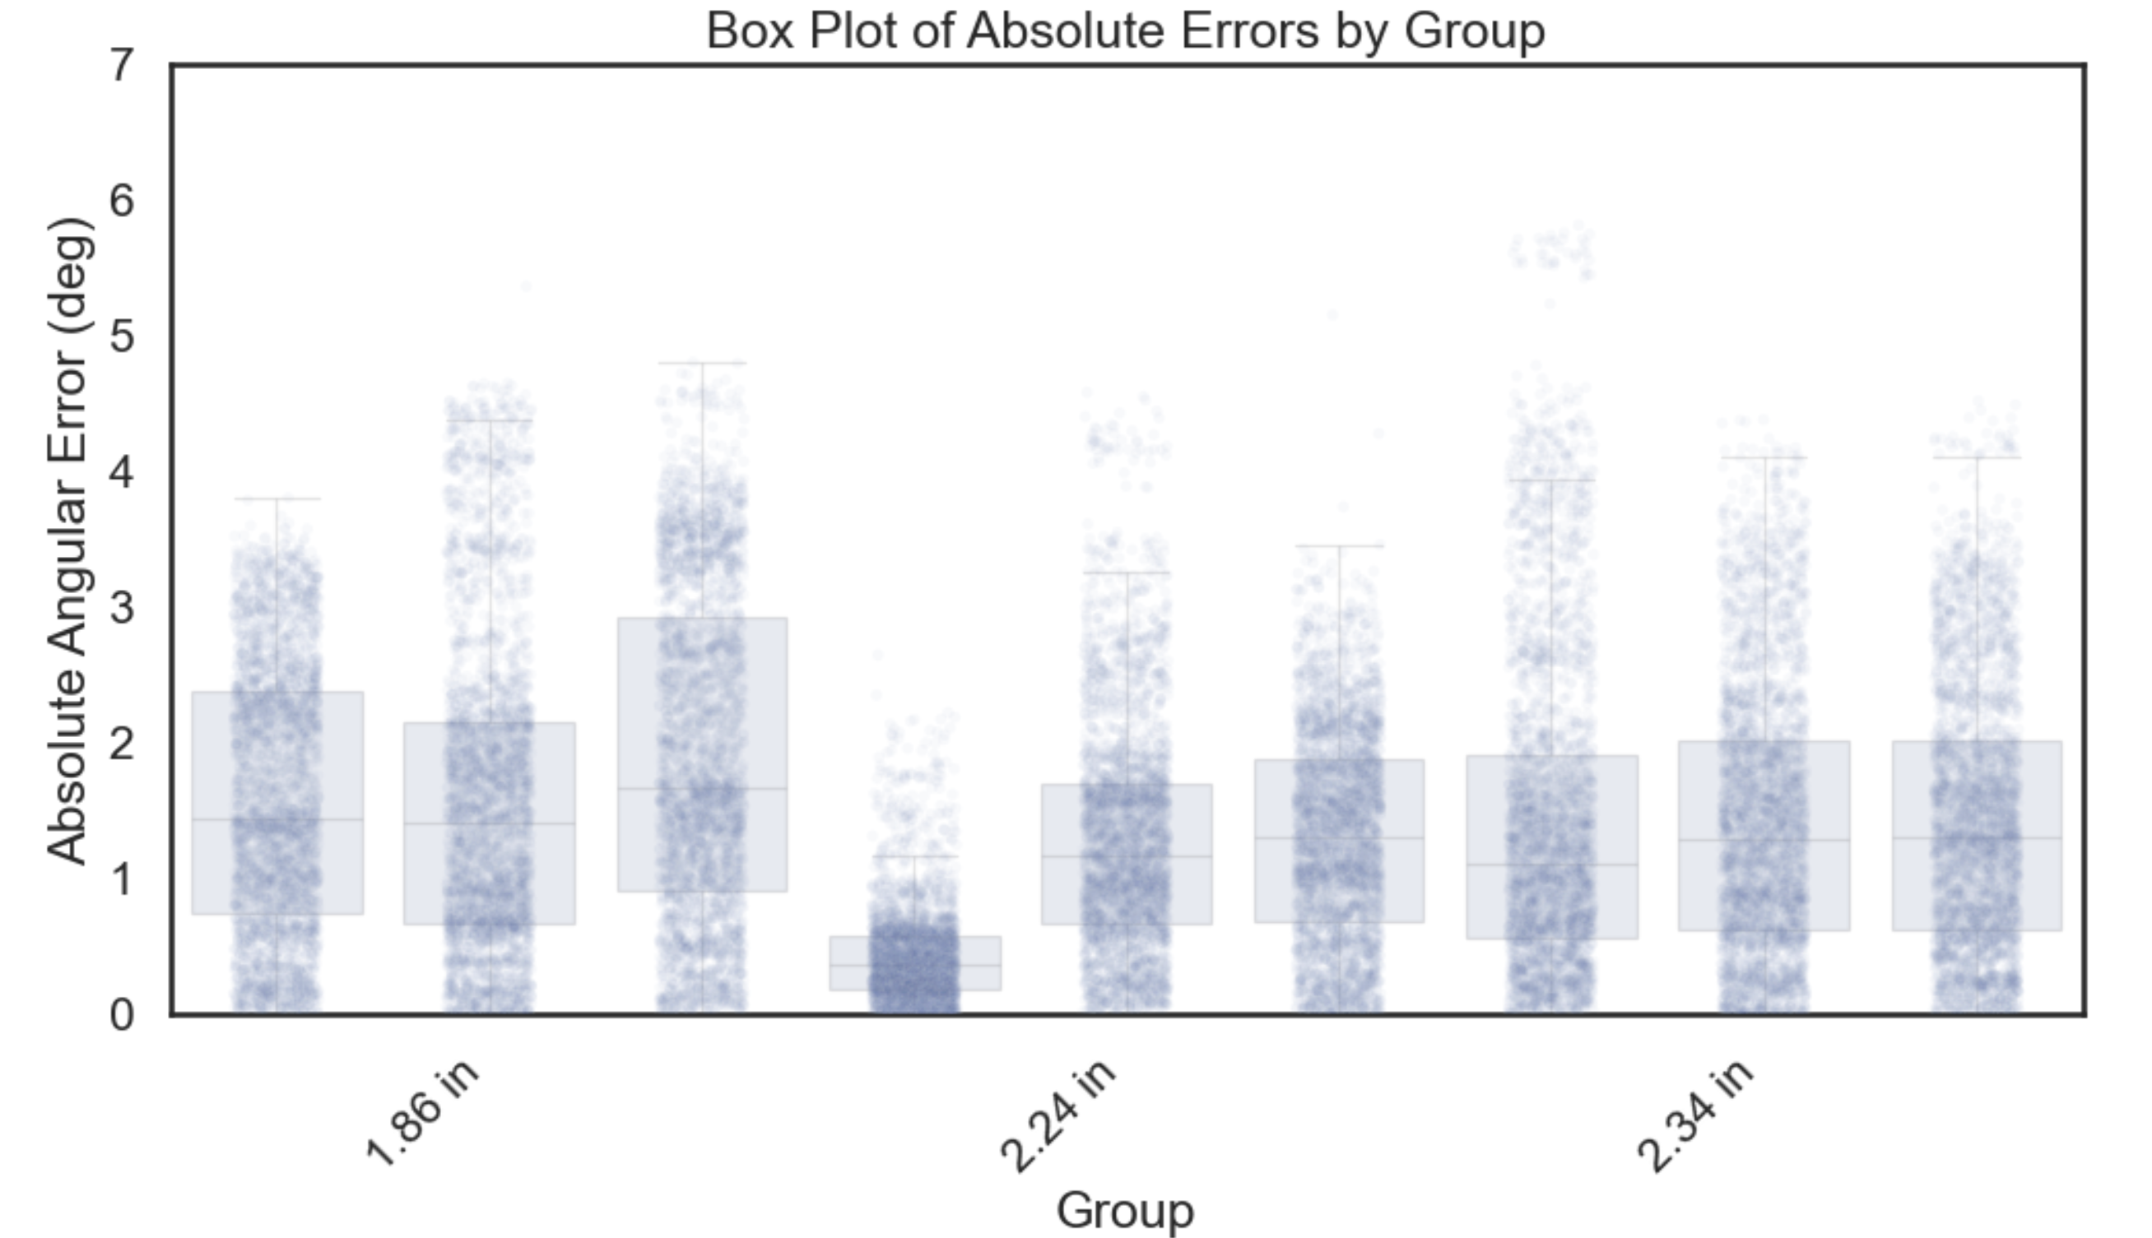
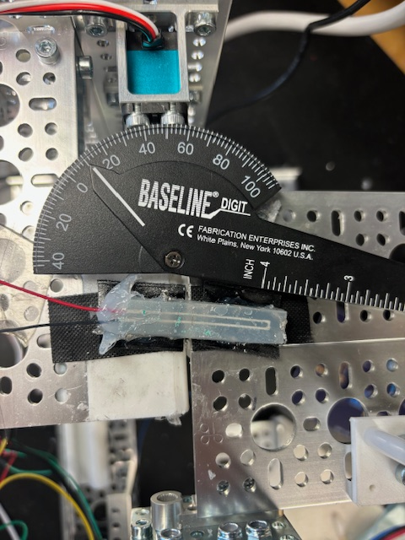
Different Length Samples Norm 0 to 1
Reapplication Data Norm 0 to 1
Misalignment Data (0, 10, 20 deg) Norm 0 to 1

Slide 12
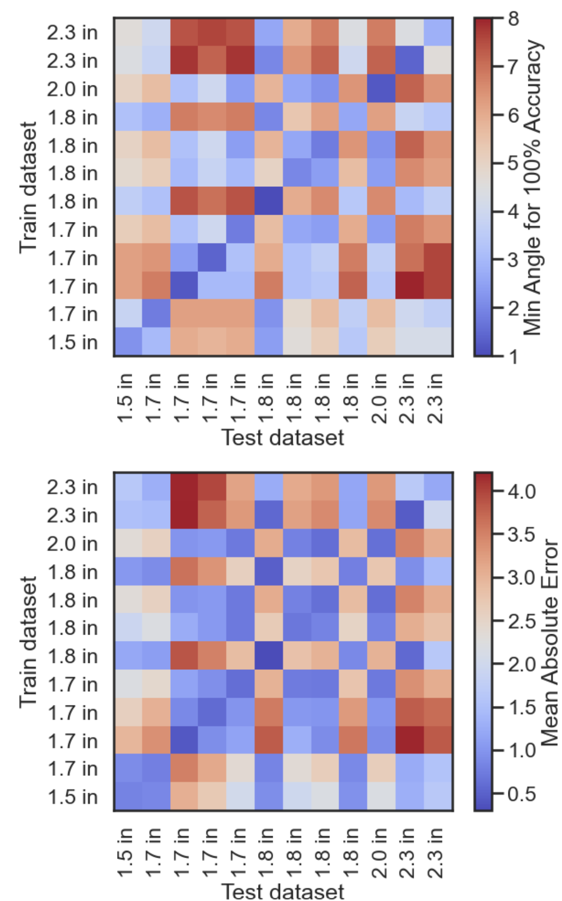
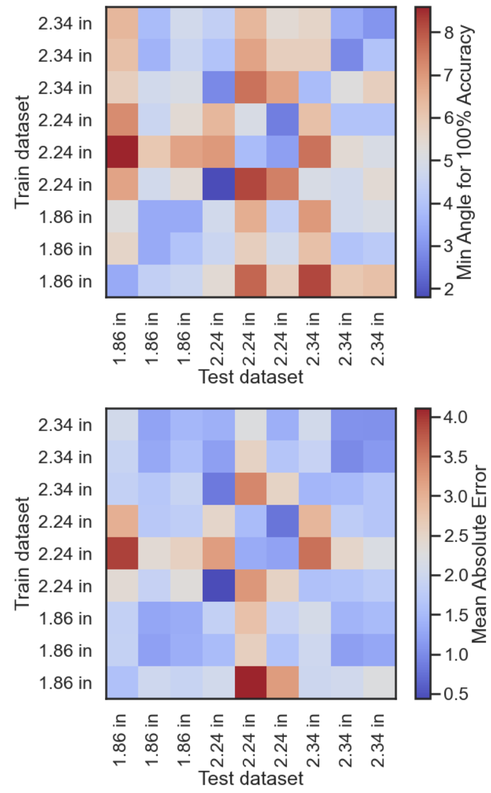
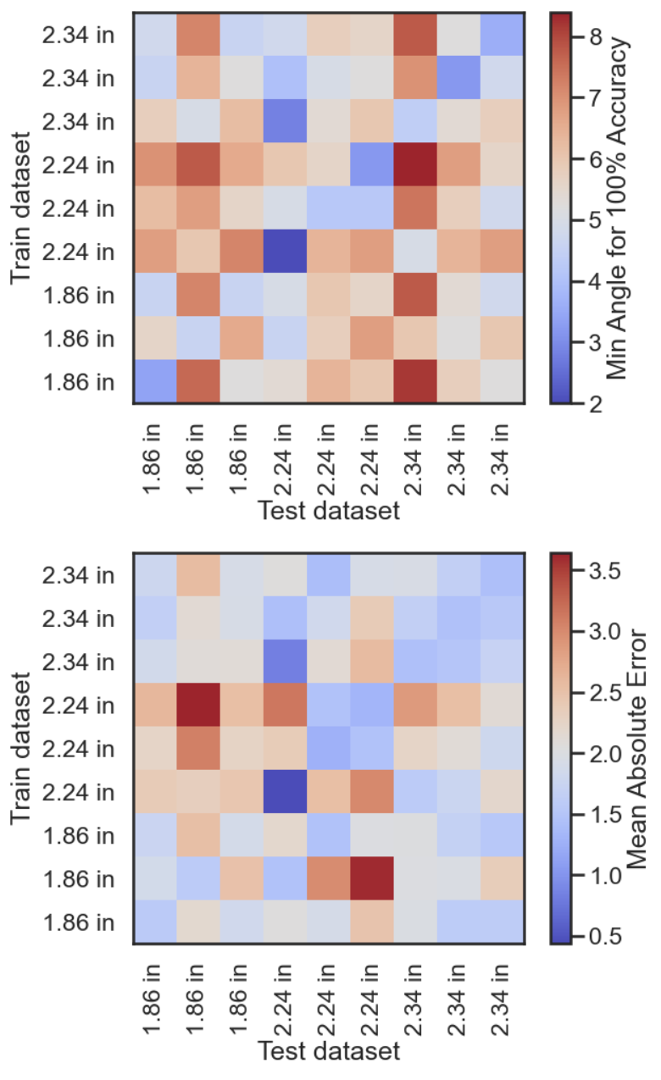
Different Length Samples Norm 0 to 1
Reapplication Data Norm 0 to 1
Misalignment Data (0, 10, 20 deg) Norm 0 to 1

Slide 13
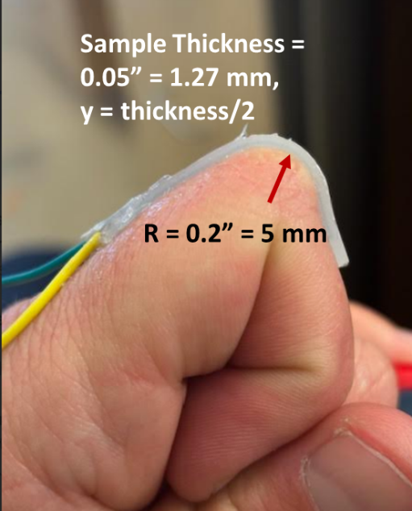
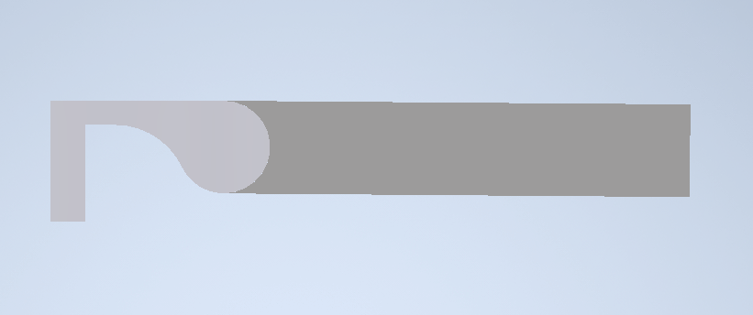
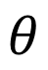
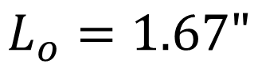
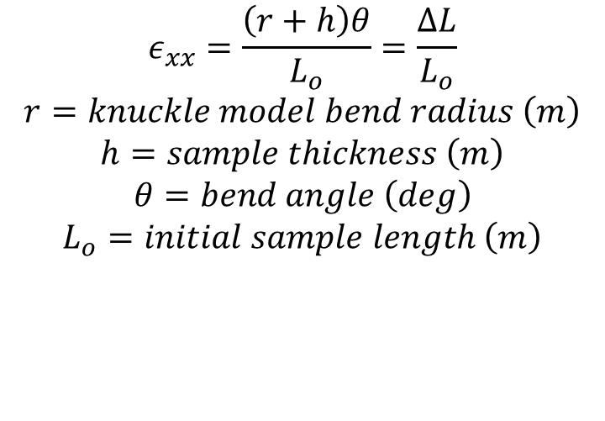
Human Knuckle Model
$$L_{o}=1.67"$$
h = 0.05” (1.27 mm)
r = 0.125”
$$θ$$
Measured Strain on finger with sample abs_100
(using strings)
~ 0.1677 or 16.8%
$$ε_{xx}=\frac{\left(r+h\right)θ}{L_{o}}=\frac{ΔL}{L_{o}}$$
$$r=knuckle model bend radius \left(m\right)$$
$$h=sample thickness \left(m\right)$$
$$θ=bend angle \left(deg\right)$$
$$L_{o}=initial sample length \left(m\right)$$

Slide 14

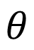
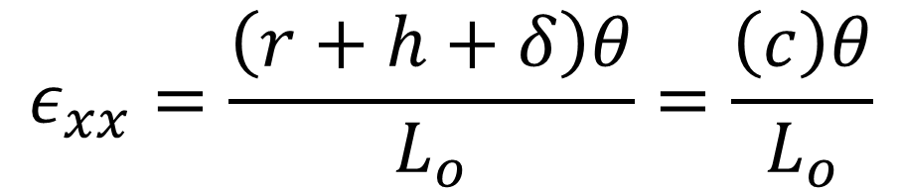
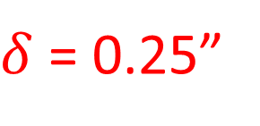
Auto Bender Model
h
r
$δ$ = 0.25”
$$θ$$
Measured Strain on sample abs_100 on AutoBender
~ 0.4 or 40%
$$ε_{xx}=\frac{\left(r+h+δ\right)θ}{L_{o}}=\frac{\left(c\right)θ}{L_{o}}$$

Slide 15
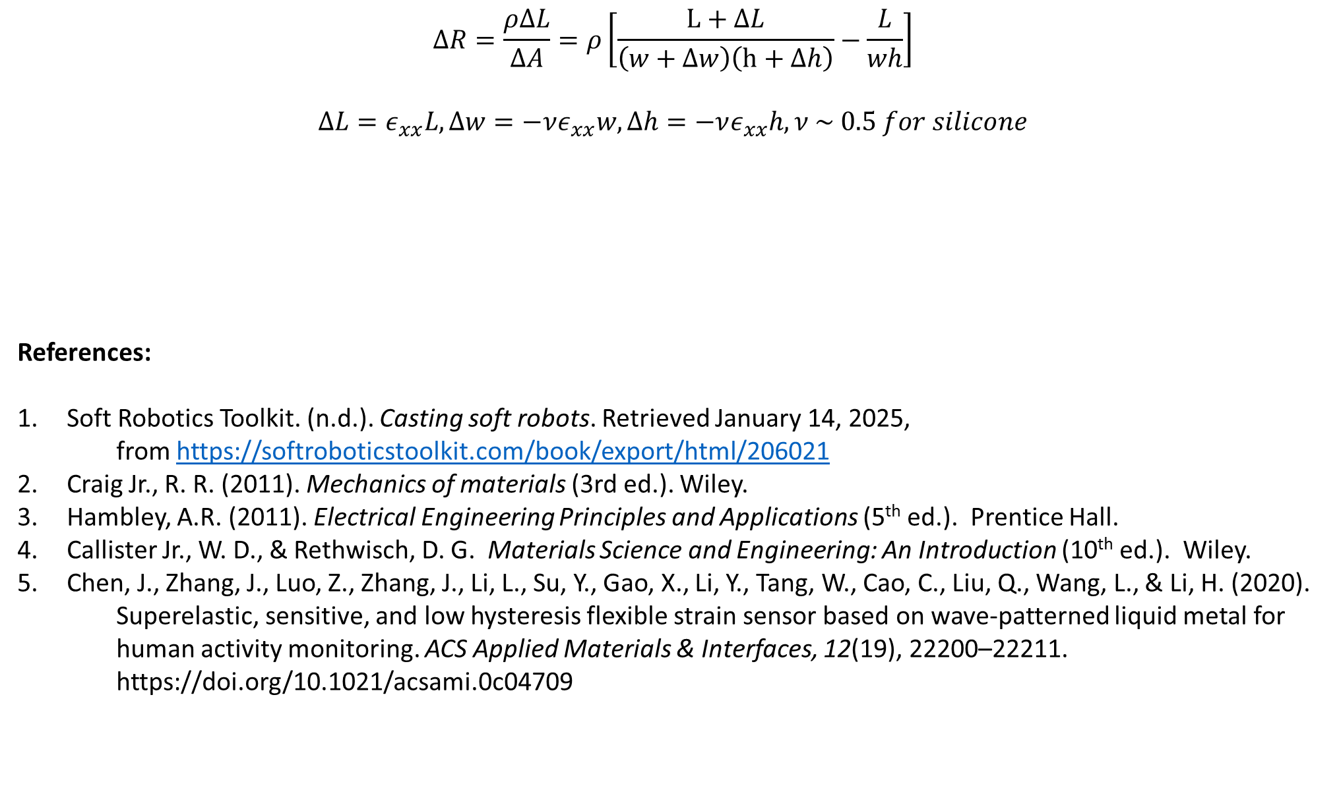
$$ΔR=\frac{ρΔL}{ΔA}=ρ\left[\frac{L+ΔL}{\left(w+Δw\right)\left(h+Δh\right)}−\frac{L}{wh}\right]$$
$$ΔL=ε_{xx}L, Δw=−νε_{xx}w, Δh=−νε_{xx}h, ν \sim 0.5 for silicone$$
References:
Soft Robotics Toolkit. (n.d.). Casting soft robots. Retrieved January 14, 2025,
from https://softroboticstoolkit.com/book/export/html/206021
Craig Jr., R. R. (2011). Mechanics of materials (3rd ed.). Wiley.
Hambley, A.R. (2011). Electrical Engineering Principles and Applications (5th ed.). Prentice Hall.
Callister Jr., W. D., & Rethwisch, D. G. Materials Science and Engineering: An Introduction (10th ed.). Wiley.
Chen, J., Zhang, J., Luo, Z., Zhang, J., Li, L., Su, Y., Gao, X., Li, Y., Tang, W., Cao, C., Liu, Q., Wang, L., & Li, H. (2020).
Superelastic, sensitive, and low hysteresis flexible strain sensor based on wave-patterned liquid metal for
human activity monitoring. ACS Applied Materials & Interfaces, 12(19), 22200–22211.
https://doi.org/10.1021/acsami.0c04709
$$ΔR=\frac{ρLε_{xx}}{wh}\left[\frac{8−ε_{xx}}{{\left(2−ε_{xx}\right)}^{2}}\right]→\frac{ΔR}{R_{o}}=\frac{ρLε_{xx}}{whR_{o}}\left[\frac{8−ε_{xx}}{{\left(2−ε_{xx}\right)}^{2}}\right]=normalized resistance where R_{o}is initial resistance$$

Slide 16
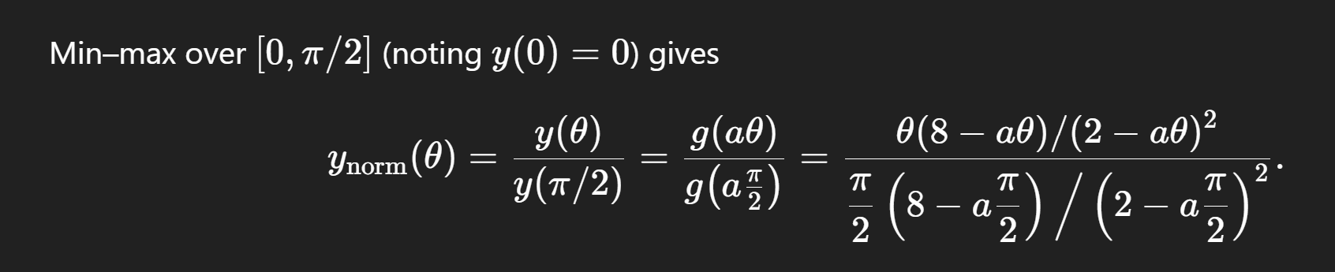
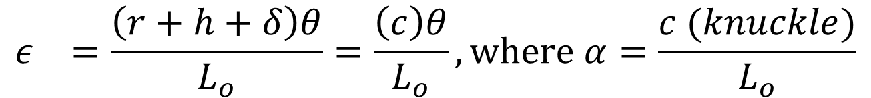

$$\frac{ΔR}{R_{o}}=\frac{ρLε}{whR_{o}}\left[\frac{8−ε}{{\left(2−ε\right)}^{2}}\right]$$
$$ε_{}=\frac{\left(r+h+δ\right)θ}{L_{o}}=\frac{\left(c\right)θ}{L_{o}}, where α=\frac{c (knuckle)}{L_{o}}$$
$$where c is bend radius , L_{o}is sample initial length before bending$$

Slide 17
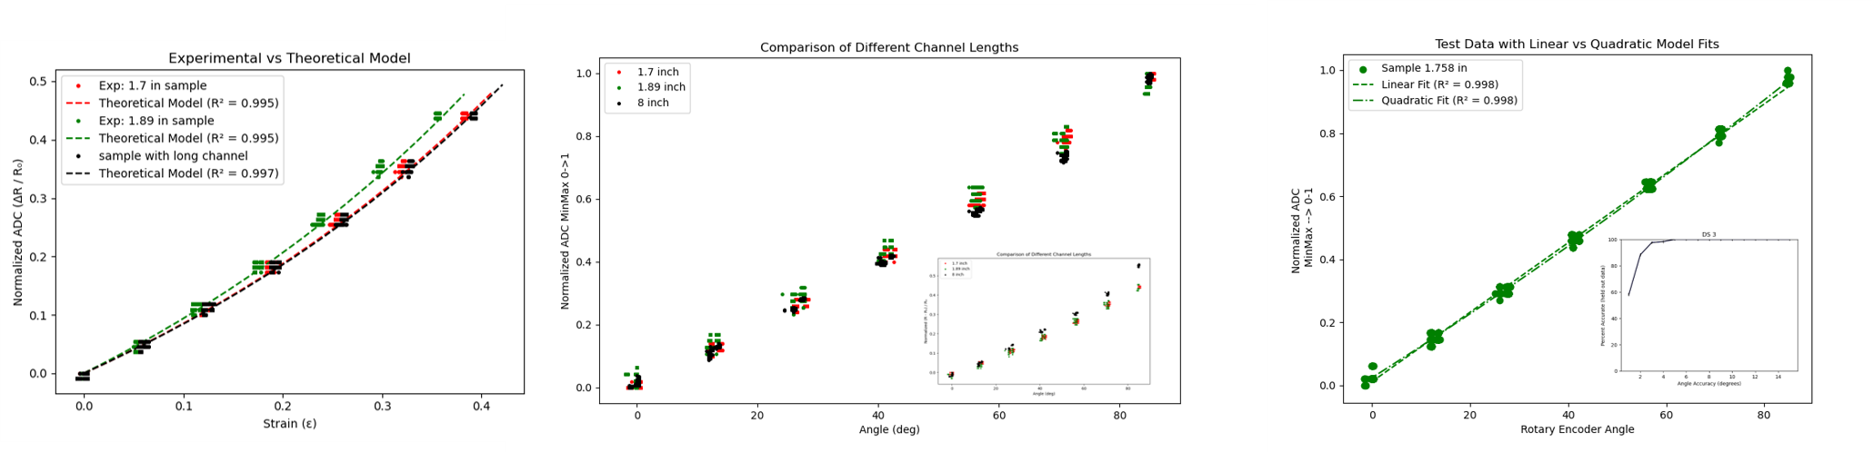
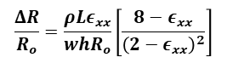
Theoretical Modeling and Curve Fitting
$$\frac{ΔR}{R_{o}}=\frac{ρLε_{xx}}{whR_{o}}\left[\frac{8−ε_{xx}}{{\left(2−ε_{xx}\right)}^{2}}\right]$$

Slide 18
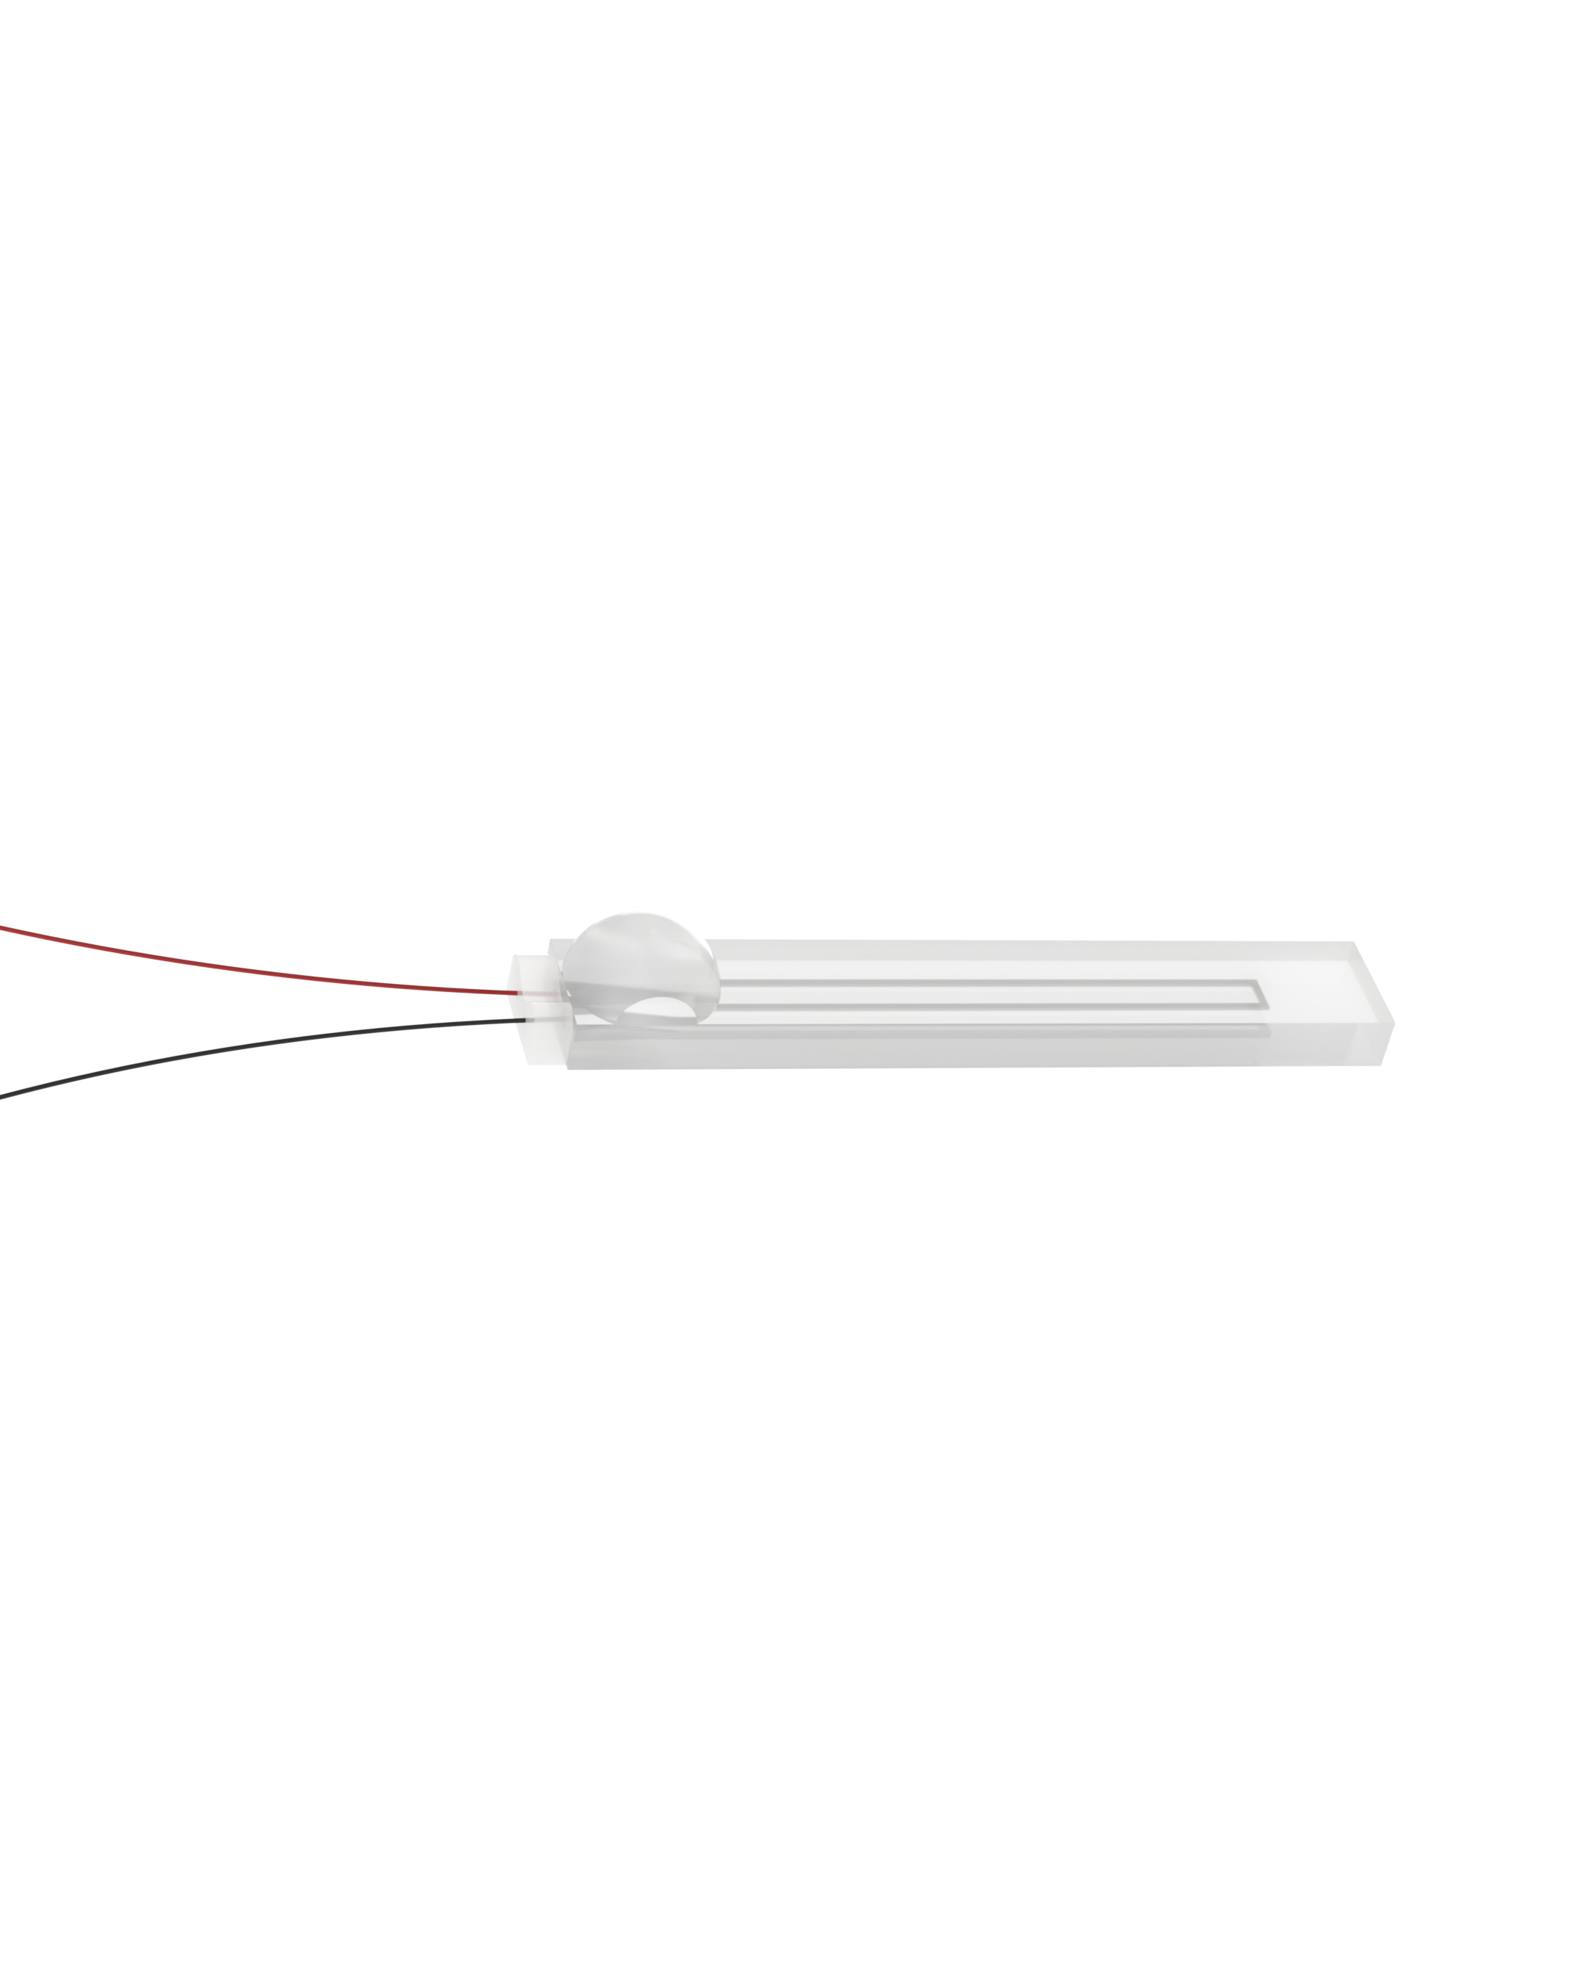
Auto Bender Varying Geometry

Slide 19
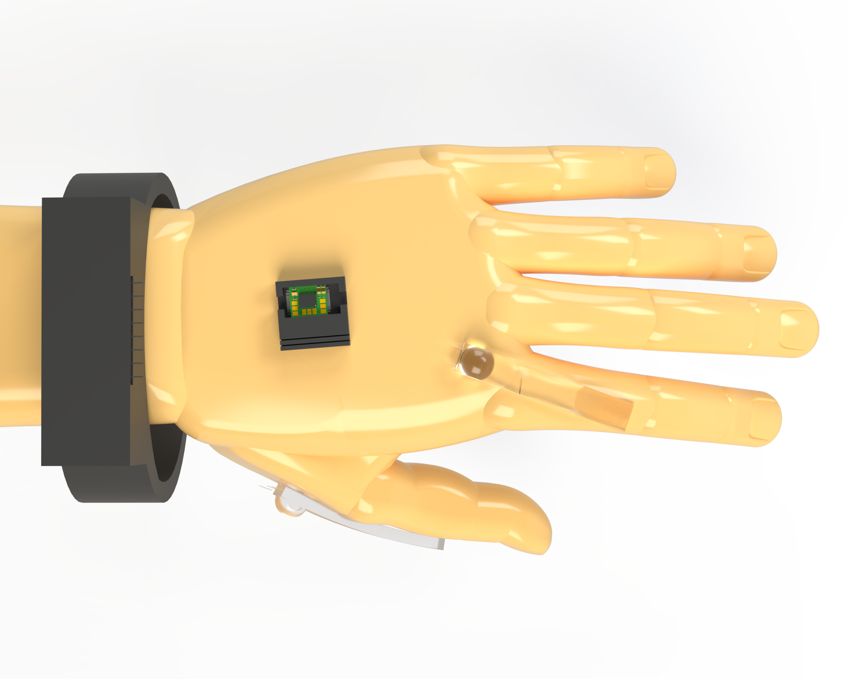
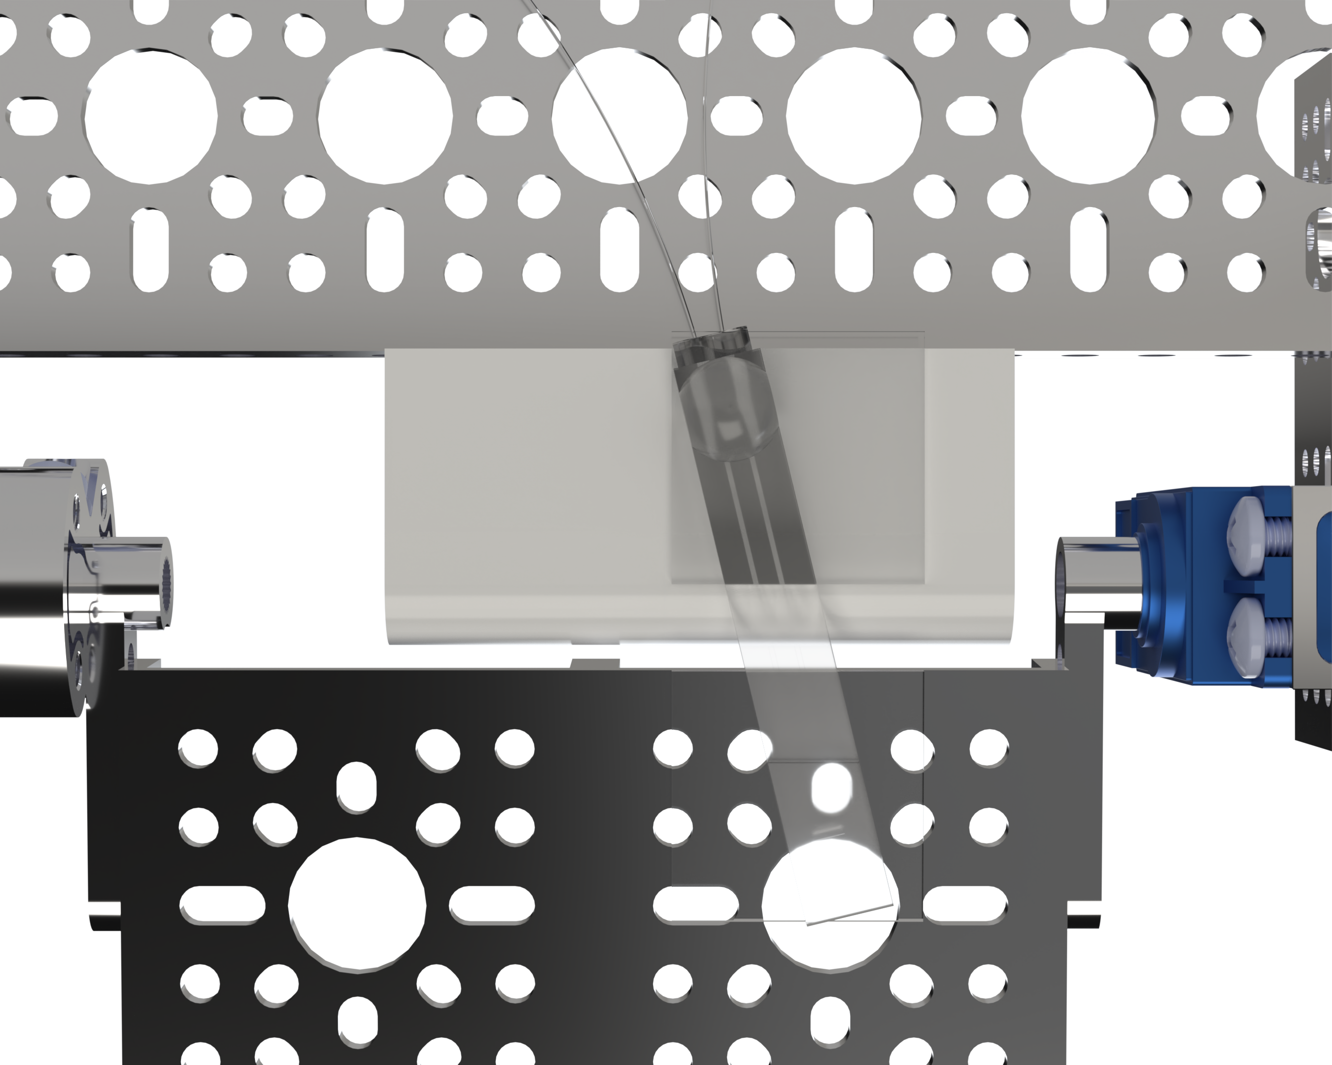
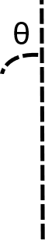
Auto Bender Misalignment Testing

Slide 20
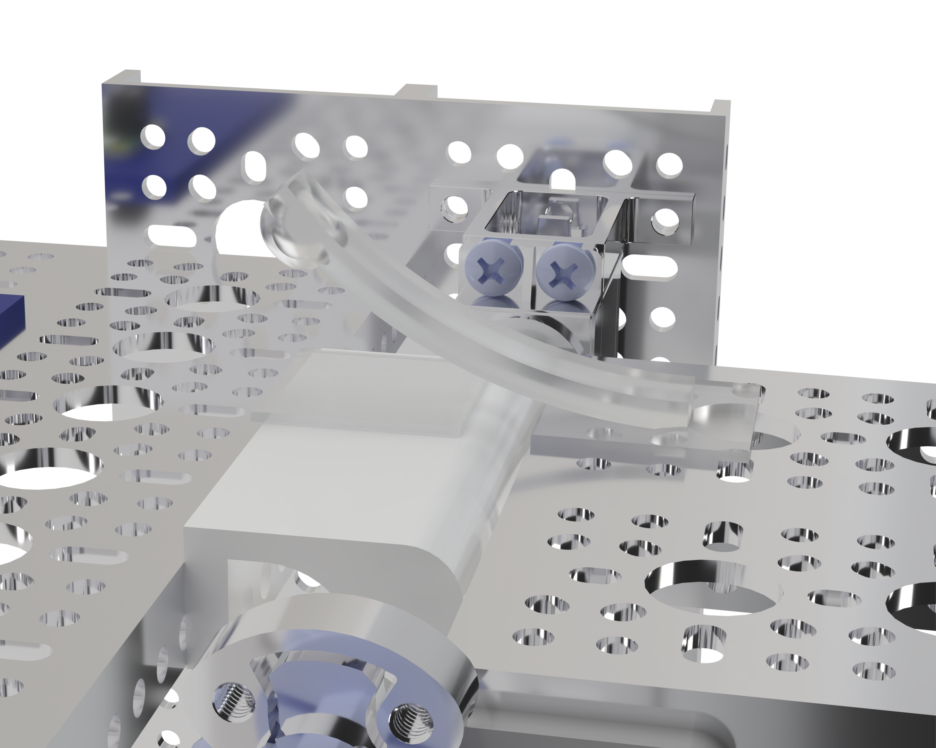
Auto Bender Reapplication Testing
Reapplication 4x per sample

Slide 21
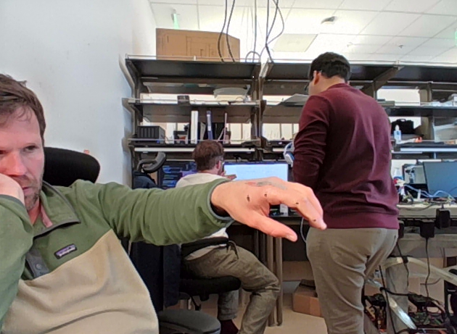
Next Steps: Redo Tests on Hand
DeepLabCut
~ 300 Frames
Extract Bend Angles per Frame
Compare bend angles to calibrated strain sensor

Slide 22
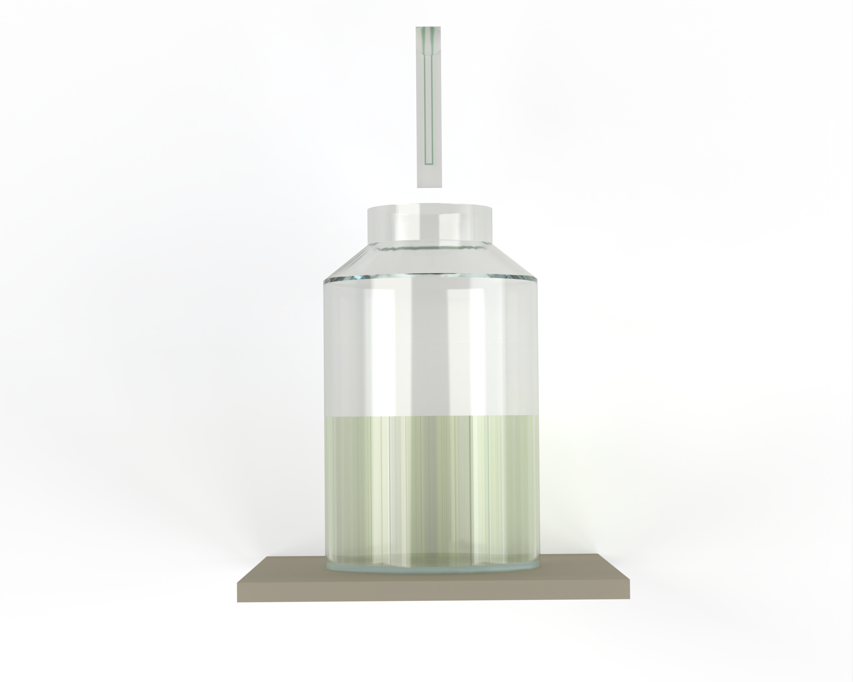
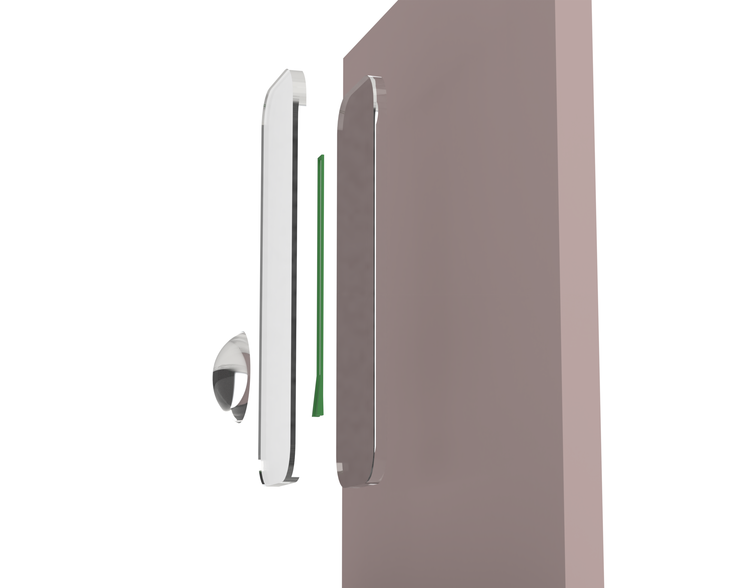
Fabrication Process

